Slide 1
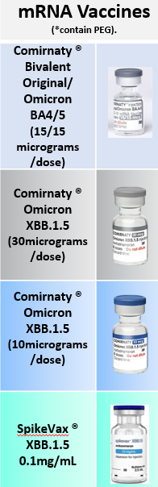
Reminder: Point of Care system Recording
The current COVID-19 vaccines deployed in the AW 23 / 24 campaign are:
Pfizer - Comirnaty ® Original / Omicron BA4-5 (grey cap)
Pfizer - Comirnaty ® Omicron XBB.1.5 30 micrograms / dose (grey cap)
Pfizer - Comirnaty ® Omicron XBB.1.5 10 micrograms / dose (blue cap)
Moderna - SpikeVax XBB.1.5 0.1mg/mL (blue cap)
Pfizer - Comirnaty ® Omicron XBB.1.5 3 micrograms /dose (magenta cap)
Sanofi - VidPrevTyn Beta ® (Green/Yellow cap)
(Message) Remain vigilant when recording the correct vaccine from the PoC system pick list.
(Why) Some of the vaccines in the drop-down pick lists are from previous phases of the programme
(Impact) Incorrect selection results in: Incorrect patient records, increased workload on clinical teams investigating errors on the system, increased time to correct patient records
Top tips – STOP, THINK, ACT
Ensure all the team are clear on the vaccine/s being used for the clinic session
If using the system stock manager tool ALWAYS SECOND CHECK vaccine batch information and name
Cross check the correct vaccine information every time you enter a patient record
Be aware, the vaccine brand name appears first so ensure you check the full details of the vaccine. Both Comirnaty ® BA1 and BA4/5 can be selected on the systems but are they not the same vaccine. There are also three different age specific XXB.1.5 Comirnaty vaccines being introduced this autumn so check the dose carefully.
Flag any issues with missing patient vaccination records to support data flow checks.
Designated sites only:
[South West Screening & Immunisations Service – COVID-19 Vaccination Programme Vaccine Expiry Support Tool (V1) Date 01/10/2023 contact email: england.swicars@nhs.net]

Slide 2
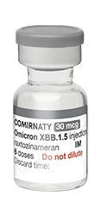
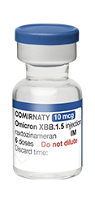
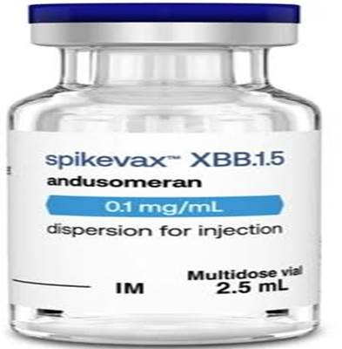
New XBB.1.5 Vaccines
RIGHT AGE | RIGHT DOSE
Comirnaty XBB.1.5 30 micrograms
Spikevax XBB.1.5 0.1mg/mL
Comirnaty XBB.1.5 10 micrograms
Dose 0.3 mL
Age 12 years and over
Dose 0.5 mL
Age 18 years and over
Dose 0.3 mL
Age 5 years to 11 years
(Note : new dose / ready to use)
Note: There are other COVID-19 vaccines in the programme. Check you have the RIGHT vaccine
Please escalate any clinical incidents to SWICARS@nhs.net NHSE SW version 1.0 11/10/23

