Slide 1
Live Flu Vaccine

Slide 2
A live attenuated influenza vaccine (LAIV) is the recommended vaccine for the childhood flu programme. Only one LAIV is available; this is marketed as Fluenz Tetra® for the UK.

Slide 3
LAIV is a quadrivalent vaccine. This means that it contains four types of flu virus: two subtypes of Influenza A virus and both B virus types.
Both B virus types are included in order to improve the potential for matching the vaccine to the circulating flu strain(s). This is important as most of the disease caused by influenza B occurs in children.

Slide 4
Live attenuation
The intranasal vaccine given to children is a live attenuated vaccine. This means that it is made from whole live viruses that have been carefully weakened (attenuated) in a lab.
As they are still live, the viruses retain the ability to replicate enough to produce an immune response (antibodies) but not enough to cause disease.
As this mimics natural infection, it induces better immune memory, thereby offering better long-term protection to children than they get from the inactivated vaccines.

Slide 5
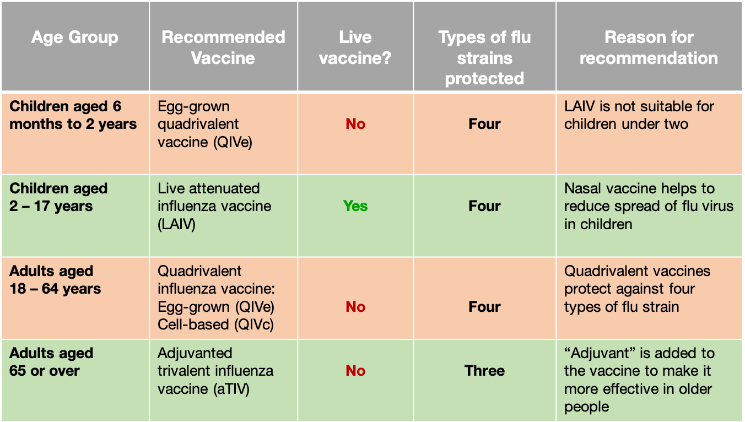

Slide 6
The 2 March 2022 letter confirmed that those eligible for the NHS influenza programme are the cohorts offered vaccine prior to the pandemic:
all children aged 2 or 3 years on 31 August 2022
all primary school-aged children (from reception to year 6)
those aged 6 months to under 65 years in clinical risk groups

Slide 7
Intranasal Flu vaccine
Given part dose in each nostril

Slide 8
Contraindications
Anaphylactic reaction
Severe asthma or active wheezing
Minor illnesses
Immunodeficiency
Egg allergy
Risk of transmission of live flu virus

Slide 9
Commonly reported adverse reactions (affects more than 1 in 10 Fluenz Tetra® recipients) include:
Blocked or runny nose
Headache
Fever
Malaise (feeling generally unwell)
Myalgia (muscle pain)
Decreased appetite
Hypersensitivity reactions (including facial oedema (swelling), urticaria (raised itchy skin rash) and anaphylaxis) can occur but are very rare.

Slide 10
As the vaccine chosen for the childhood flu programme is a live vaccine, it is important that immunisers are aware of the contraindications and precautions to this vaccine
Those children who are contraindicated to receive the live flu vaccine should be offered an age appropriate inactivated flu vaccine
Efficacy, safety and quality may be adversely affected if the live intranasal flu vaccine is not stored or administered as specified in the product license

