Slide 1
Influenza
Michelle Davidson

Slide 2
Influenza What do we Know

Slide 3
Learning objectives
By the end of this session you will be able to:
Recognise
Recognise the cause of flu, how it is transmitted, the symptoms and the possible complications
Describe
Describe the changing nature of flu viruses and how this affects vaccine effectiveness
Explain
Explain why flu vaccine needs to be given to eligible patients every year
Discuss
Discuss the evidence base for the administration of flu vaccination to those aged 65 years and over, those in clinical risk groups and to healthy children
Recall
Recall the different types of flu vaccines available

Slide 4
Before administering flu vaccines you should have:
Received practical training in vaccine administration
An appropriate legal framework to supply and administer the vaccine e.g. Patient specific prescription, Patient Specific Direction (PSD) Patient Group Direction (PGD), National Protocol (Reg247A) or a Written Instruction (for use in the course of an Occupational Health Scheme, Schedule 17)
Recently undertaken training in Basic Life Support and management of anaphylaxis
Have training on vaccine storage/ordering

Slide 5
Flu is an acute viral infection of the respiratory tract. It is a highly infectious illness which spreads rapidly.
How is flu transmitted?
How long is the incubation period?
What are the symptoms of flu?
What are the possible complications?

Slide 6
How is Flu transmitted?
It is transmitted by droplets, aerosol, or through direct contact with the respiratory secretions of someone with the infection.
Even people with mild or no symptoms can infect others.

Slide 7
What are the Symptoms of Flu?

Slide 9
What are the symptoms of flu?
For healthy individuals, flu is an unpleasant but normally self-limiting disease with recovery usually within two to seven days.
Common symptoms include:
Sudden onset of fever, chills, headache, muscle and joint pain and extreme fatigue
Dry cough, sore throat and stuffy nose
In young children, gastrointestinal symptoms such as vomiting and diarrhoea may occur

Slide 10
What are the Complications of Flu?

Slide 11
What are the possible complications?
Common complications include:
Bronchitis
Otitis media (children)
Sinusitis
Secondary bacterial pneumonia
Less common complications include:
Meningitis, encephalitis, meningoencephalitis
Primary influenza pneumonia
The risk of most serious illness is highest in children under 6 months, pregnant women, older people and those with underlying health conditions.
Flu during pregnancy may be associated with perinatal mortality, prematurity, smaller neonatal size and lower birth weight.

Slide 12
Flu Vaccines

Slide 13
Flu Vaccine
Flu vaccine efficacy is usually around 30-60% for adults aged 18-65 years. It is lower in the elderly.
In recent years, new flu vaccines such as adjuvanted, cell-based, recombinant and quadrivalent vaccines have been introduced in order to try to improve protection
Mismatches between the components in the vaccine and circulating viruses do occur from time to time and this explains why vaccine effectiveness varies from year to year.
In most recent years (except 2017/18), flu vaccines have closely matched the influenza A viruses circulating during the flu season.
It is important to remember that flu vaccination remains the best way to protect people from flu. It not only protects people who have received the vaccine, but also those around them. Everyone eligible should be encouraged to take up the offer of flu vaccine each winter.

Slide 14
Flu Vaccine
Three key potential factors that may lead to reduced vaccine effectiveness
Immunosenescence Age related reduction in immune response to vaccination May be addressed by the use of an adjuvanted or higher dose vaccine to boost response in older people
Genetic drift of the circulating strain Genetic changes in the flu virus can create a mismatch between the vaccine virus strains and the circulating wild type strains The WHO recommendations for the vaccine strains for the forthcoming flu season reflect any changes seen in the circulating flu viruses
Egg adaptation To produce most flu vaccines, the flu viruses are injected into eggs to generate large amounts of flu virus. However, the viruses adapt to live in the egg, leading to changes in the viruses which means they may not exactly match the circulating virus, thus resulting in reduced vaccine effectiveness. Egg adaptation can be addressed using cell based vaccines which do not require the use of eggs in the manufacturing process

Slide 15
How Do Vaccines Work
https://www.youtube.com/watch?v=tMTl3gU0mFc
https://youtu.be/tMTl3gU0mFc

Slide 16
Who should be considered for immunisation against flu during 2022/23?

Slide 17
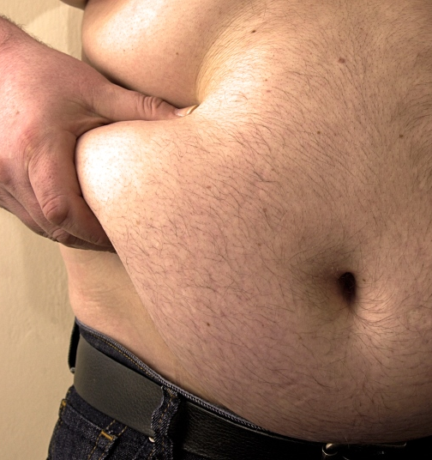
Obesity
The JCVI have advised that morbid obesity (defined as BMI 40 and above) should be considered as a risk factor for flu vaccination.

Slide 18
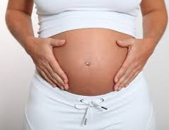
Pregnancy
All pregnant women are recommended to receive the inactivated flu vaccine irrespective of their stage of pregnancy.
Pregnant women are at increased risk from complications if they contract flu. F
Flu during pregnancy may be associated with premature birth and smaller birth size and weight.
It also provides passive immunity against flu to infants in the first few months of life

Slide 19
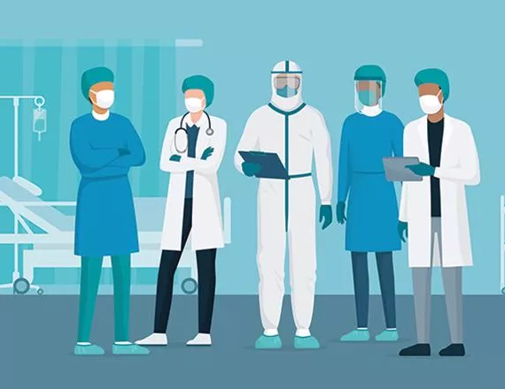
Healthcare workers
Vaccination of healthcare workers against flu has been shown to significantly lower rates of flu-like illness, hospitalisation and mortality in the elderly in long-term healthcare settings.
Vaccination of health and social care workers also helps reduce the level of sickness absenteeism that can jeopardise the NHS and care services.

Slide 20
Eligibility
Chronic Respiratory Disease
Chronic Heart Disease
Chronic Kidney Disease
Chronic liver Disease
Chronic Neurological Conditions
Diabetes
Immunosuppression
No spleen

Slide 21
Eligibiity
all children aged 2 or 3 years on 31 August 2022
all primary school aged children (from reception to Year 6)
those aged 6 months to under 65 years in clinical risk groups
pregnant women
those aged 65 years and over
those in long-stay residential care homes
carers

Slide 22
close contacts of immunocompromised individuals frontline staff employed by the following types of social care providers without employer led occupational health schemes: a registered residential care or nursing home registered domiciliary care provider a voluntary managed hospice provider Direct Payment (personal budgets) or Personal Health Budgets, such as Personal Assistants

Slide 23
Common Misconceptions
The flu vaccine can give you flu.
Although people sometimes say that the vaccine gave them flu, this is not possible.
The flu vaccines in the UK are inactivated and do not contain live viruses. It is most likely that any flu-like symptoms experienced by people who have just had the vaccine are caused by either:
One of many other circulating viruses that can produce flu-like symptoms
Having contracted flu infection in the 2 weeks following vaccination before the immune system has had sufficient time to develop an immune response to the vaccine
The body's immune system responding to the vaccine
You don't need flu vaccine if you're fit and well, eat healthy food and exercise.
Flu can infect anyone, including those who are usually fit and well.
In 2009/10 and 2010/11, up to one third of deaths from flu were in people considered healthy. Many cases of severe illness were in those aged under 65 years.

Slide 24
The flu vaccine doesn't work.
Most people who have the flu vaccination will not get flu.
Even when flu is not completely prevented by vaccination, those who have received the vaccine may have some protection that could reduce the severity of their symptoms.

Slide 25
Inactivated Flu Vaccines

Slide 26
There are four types of inactivated flu vaccine:
Whole virus vaccines contain whole viruses which have been inactivated
Split virion inactivated vaccines contain flu viruses which have been exposed to organic solvents or detergents to disrupt the virus membranes
Surface antigen (sub-unit) inactivated vaccines contain only the viral surface antigens, haemagglutinin and neuraminidase, taken from the whole virus.
Recombinant (prepared in cell culture) inactivated vaccine contains only the purified hemagglutinin (HA) proteins

Slide 27
The split virion, surface antigen and recombinant inactivated vaccines are available to order in the UK and all available vaccines have been through a purification process and have been inactivated. There is no difference in efficacy or adverse reactions between these types of vaccines.

Slide 28
All but one of the vaccines available in the UK are inactivated and do not contain live viruses. They therefore cannot cause flu in those that can be vaccinated. In previous years, inactivated flu vaccines have been: Trivalent (TIV) contain two subtypes of Influenza A and one type B virus Quadrivalent (QIV) contain two subtypes of Influenza A and both B virus types. Quadrivalent vaccines are now recommended for all age groups.

Slide 29
How Are Flu Vaccines Administered
All of the inactivated flu vaccines are administered by intramuscular injection. Some flu vaccines are restricted for use in particular age groups.
The Summary of Product Characteristics (SmPC) for individual products should always be referred to when ordering and before administering flu vaccines.
Due to the presence of the adjuvant in the adjuvanted quadrivalent vaccine (the recommended vaccine for those aged 65 years and over), it should be administered intramuscularly using a 25 mm needle to enable the vaccine to be delivered into the muscle.

Slide 30
JCVI Advice on Vaccines for 2022/23 Season Adults over 65 years – aQIV, QIV-HD, QIVr At Risk – QIVc, QIVr Age 2-18 years – LAIV, QIVc Under age 2 - QIVe

Slide 31
Contraindications and Precautions
Anaphylactic Reaction
Other allergic conditions
Immunosuppression and HIV infection
Egg allergy

Slide 32
Inactivated Flu Vaccine
Ordering
Storage
Consent
Legal aspects
Administration
Recording

Slide 33
Resources
The Green Book
https://www.gov.uk/government/publications/influenza-the-green-book-chapter-19
https://www.gov.uk/government/collections/annual-flu-programme
https://www.gov.uk/government/publications/national-flu-immunisation-programme-plan
https://vk.ovg.ox.ac.uk/vk/influenza-flu

