Slide 1
BECOMING A TIER 2 VISA SPONSOR
A GUIDE FOR GP PRACTICES
December 2019
Guidance developed by the Department of Health and Social Care

Slide 2
Introduction to becoming a sponsor
If you want to recruit a GP from outside the EU, it is highly likely they will require a Tier 2 visa and that you will need to sponsor them. This ensures:
The Home Office knows they have secured a job in the UK; and
That an employer is able to take responsibility for them while they are here.
To do this, GP practices will need a sponsorship licence. This process is not complex but the guidance around it is and can be very off-putting. This is because the official Home Office guidance needs to cover every sector in the economy, along with every possible scenario.
This guide is a simplified version that should help you:
Complete the online registration process; and
Identify the right documents you’ll need to send to the Home Office as part of your registration.
Please note, we have only provided guidance on the questions which we think will be the most difficult to answer, not the entire application form. We have indicated which part of the process is being described on each slide.
This guidance does not replace official Home Office guidance, but should help you get through the registration process with ease.
Let’s get started…

Slide 3
What you need before you start
DOCUMENTS
It can be difficult to identify which documents you need to provide to the Home Office. A simplified list is below. These documents are just designed to prove you’re a legitimate employer.
Mandatory documents:
Corporate/Business Bank Statement;
Employers Liability Insurance Certificate; and
CQC registration document.
Any 2 further documents from the following list:
HMRC Registration – PAYE Reference Number/Account Office Reference Number
Proof of business premises ownership/Fixed Assets ownership/Lease
Supporting letter from your bank manager
HMRC Registration – VAT
HMRC Company Tax Forms CT603 AND CT600
You will also need the GMC registration details of the senior partner of the GP practice, and your RCGP registration details if you are a teaching practice.
KEY PEOPLE
In order to complete an application, you will need to assign three key roles to manage your sponsorship process. These roles can all be filled be the same person if you want. These roles are:
Authorising officer (AO) – this will be your most senior person responsible for the recruitment of all migrant workers and ensuring that all of your sponsor duties are met.
Key contact – this person will act as the main contact between the Home Office and the practice.
Level 1 user – this person will carry out your day-today sponsorship activities.
Level 2 user – this is an optional role and you do not need to initially assign it (typically used by very large employers).
For a full description of each role, please click here.
COST
The cost depends on the size of your practice. For small or charitable sponsors the fee is £536. For a medium or large sponsor the fee is £1,476. You’re usually considered a small business if your annual turnover is £10.2 million or less, or if you have 50 employees or fewer.
This fee is non-refundable, even if your application is rejected.

Slide 4
The registration process and setting up
your online account
Setting up an online account (2 minutes)
Completing the online form (20 minutes)
Finding the relevant documents (10 minutes, depending on how good your filing is!)
Setting up an online account
To set up an account, click here*; then:
Enter your name and your email address.
The next page will give you a short UserID. Keep this safe, you’ll need it each time you log in.
You will be emailed a temporary password – click the link in the email to reset your password to something memorable and secure. Keep this safe and log into the system.
* https://www.points.homeoffice.gov.uk/gui-sponsor-jsf/Register/SponsorRegister.faces

Slide 5
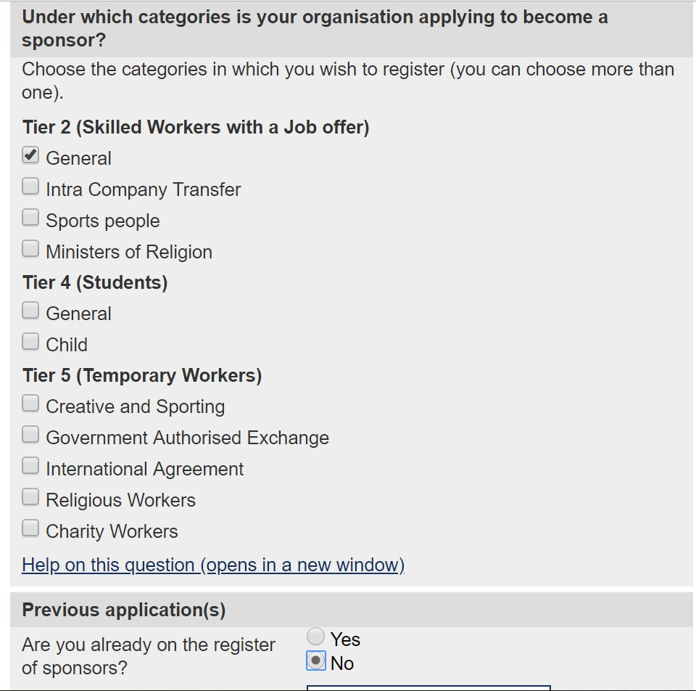
The Online Application
Tier and Categories: Step 1 of 1
Having logged onto the application system, click ‘Apply for a sponsor licence’.
This will take you to your first questions, about kind of licence you require. Choose Tier 2: General
Where it asks if you are already on the register of sponsors, select: No

Slide 6
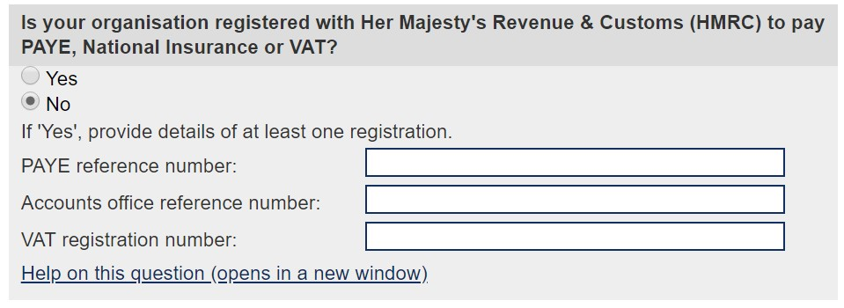
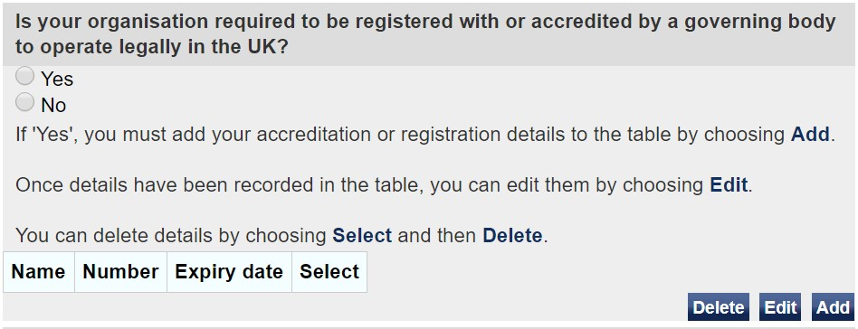
The Online Application – Organisation
Organisation: Step 3 of 4
What type of organisation is the practice. It is likely that the practice will be a Partnership, Limited Liability Partnership (LLP) or a limited company. If you are unsure, check the practice’s incorporation documents.
When asked what sector your organisation operates in, you should select ‘Human Health and Social Work Activities’.
The practice will likely pay both PAYE tax and National Insurance, because the practice has employees. The practice may also have a VAT registration number.
It is important to provide this information because your HMRC registration will help the Home Office to confirm the authenticity of the practice and who the people working at the practice are.
Next you will need to provide details of any memberships or accreditations that the practice is legally required to have with a governing body. We recommend that you use your CQC registration documents. Your CQC registration is legally required and so this satisfies the Home Office criteria for this option. These details will include the governing bodies name, your registration number and when your membership expires.
You will also need to provide details of any non-legally required memberships or accreditation. Specifically, this the GMC membership details of the senior partner at the GP practice and your RCGP registration details if you are a teaching practice.

Slide 7
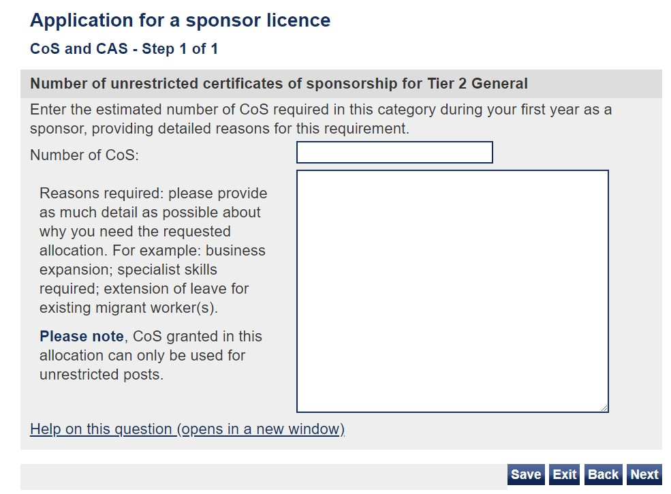
The Online Application – CoS
You’ll now need to enter how many Certificates of Sponsorship (CoS) you need and explain why.
There is a limit of 2000 characters for this part of the question, so a succinct, fact-based approach is best.
The form also states “Please note, CoS granted in this allocation can only be used for unrestricted posts.” This doesn’t affect your application as all of your Tier 2 CoS will be unrestricted.
We suggest using the following text when explaining why you need CoS:
The UK has a national shortage of qualified General Practitioners to meet the growing demands of the population. Typical recruitment efforts have not provided us with the suitable candidates required to fulfil General Practitioner roles within our practice. The impact of this is extended waiting times for patients and greater pressure on our current workforce to meet the needs of our patients.
The role of a General Practitioner is one that requires many years of specialist training including: a full medical degree, two years of foundation medical training and at least three years of specialist GP training. While there are concerted national efforts to increase the numbers of available GPs in the UK, this does not address the immediate pressure in our service and, for this reason, we anticipate needing to recruit from overseas.
The role of a General Practitioner has been included on the UK Shortage Occupation list as of 6 October 2019.

Slide 8
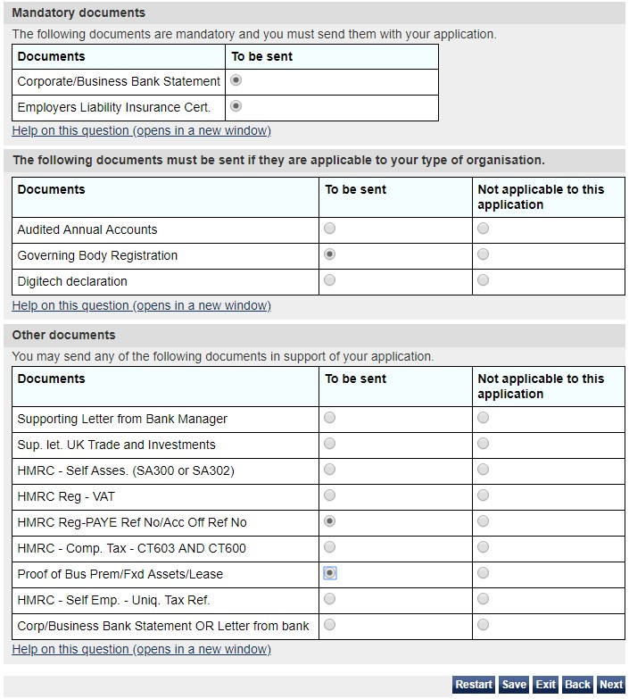
The Online Application – Documents
Remember the documents you pulled together from the lists on slide 3? This next page asks you to tick-off the ones you have to support your application.
For the full Home Office guidance on supporting documents please click here.
We recommend that, in providing ‘Governing Body Registration’ documents, you use your CQC registration documents. Your CQC registration is legally required and so this satisfies the Home Office criteria for this option. The guidance states that you do not need to provide your registration documents because the Home Office can conduct its own checks. We recommend that you provide the registration documents with your application in order to avoid unnecessary delay.
You must choose 2 documents from list in the section entitled ‘Other documents’. If you fail to provide at least two further documents, your application may be refused by the Home Office.
You must send original documents or certified copies. A certified copy is one that includes a signed statement, either by the issuing authority or by a solicitor or notary, confirming that it is an accurate copy of the original document.

Slide 9
Final steps and useful contacts
Your application is not complete until you have paid and sent the Home Office your submission sheet and supporting documents.
Information on where to send your submission sheet and supporting documents are provided at the end of the application process, once your payment has been made.
Help and advice
If you do have any difficulty with the application, further advice can be obtained from the sponsorship, employer and education helpline:
Telephone:
0300 123 4699 Monday to Thursday, 9am to 5pm Friday, 9am to 4:30pm
Or email
Businesshelpdesk@homeoffice.gsi.gov.uk

Slide 10
Costs and reimbursement
Expense type | Cost incurred before 6 October 2019 | Cost incurred on and after 6 October 2019 | Reimbursement
Tier 2 visa application costs for the sponsored GP and their family | Usually £704 per person, but variable dependent on circumstances. See https://www.gov.uk/tier-2-general | Usually £464 per person, but variable dependent on circumstances. See https://www.gov.uk/tier-2-general | NHS England & NHS Improvement will reimburse visa costs (and relocation where agreed) to the doctor. Doctors must submit their claims to their employing practice, attaching proof of purchase, and funds will be approved by NHS England and sent to the to the practice via the relevant regional or local teams. Only costs that were incurred after 1 June 2018 will be reimbursed.
Relocation costs for the sponsored GP and immediate family. Family is classed as those that will live at the GP’s home address in England | Up to £5000 | Up to £5000
Tier 2 Sponsorship Licence | £536 for small sponsors £1,476 for medium and large sponsors https://www.gov.uk/uk-visa-sponsorship-employers/apply-for-your-licence | £536 for small sponsors £1,476 for medium and large sponsors https://www.gov.uk/uk-visa-sponsorship-employers/apply-for-your-licence | NHS England & NHS Improvement will only meet any costs that were incurred after 1 June 2018 up until 31st March 2020. Practices will need to self fund after this date.
Certificate of Sponsorship costs | £199 per certificate. See https://www.gov.uk/uk-visa-sponsorship-employers/sponsorship-certificates | £199 per certificate. See https://www.gov.uk/uk-visa-sponsorship-employers/sponsorship-certificates
The first 2 years of the Immigration Skills Charge for any GP employed and sponsored on a tier 2 visa | £728 for small sponsors; £2,000 for medium or large sponsors. See https://www.gov.uk/uk-visa-sponsorship-employers/immigration-skills-charge | £728 for small sponsors; £2,000 for medium or large sponsors. See https://www.gov.uk/uk-visa-sponsorship-employers/immigration-skills-charge
For more information on reimbursement please contact England.Intrecruitment@nhs.net

