Slide 1
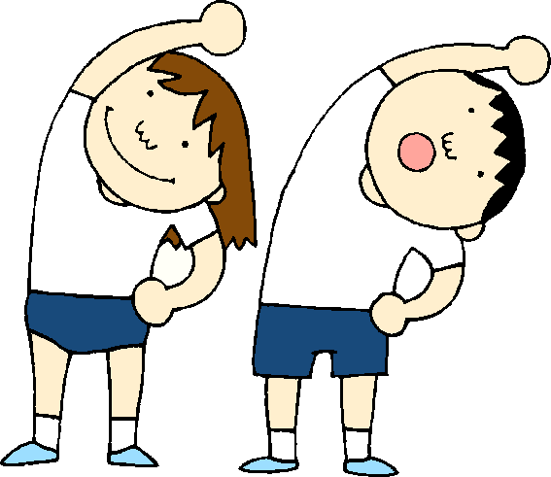
Somerset CCG ,Somerset General Practice Education Trust (SGPET) & Somerset NHS Foundation Trust
When is it Safe to Exercise Post COVID 19? Exercise for people with Long term Conditions
An evidence based webinar
4th Sept 2020 12-2pm via Zoom
Presentations by Henk Bruggers (GPwSI in diabetes, Frome) Sathish-Kumar Parasuraman (Cardiologist Musgrove Park Hospital) Steve Holmes (GP with respiratory interest, Shepton and Tom McConnell (Cardiologist Musgrove Park Hospital) along with other colleagues .
We will discuss exercise and practical tips for safe exercising advise for people with Long Term Conditions (LTC) (cardio / resp / diabetes); people after COVID ; people shielding who are unfit;
This is designed to be relevant to all clinicians who should be encouraging the population to exercise safely.
All welcome. To register contact lmc.sgpet@nhs.net
(If already a SGPET member, please book via the SGPET Website)

