Slide 1
A Patient Safety Initiative co-produced by
West Hampshire CCG & Wessex Patient Safety Collaborative
This presentation has been collated by Patricia Hymas RN RM Msc MBA, Somerset CCG and
Jude Glide RGN PGCE Somerset LARCH Collaborative
with thanks to
West Hampshire CCG & Wessex Patient Safety Collaborative
for allowing the use of a selection of their RESTORE2mini slides
2019

Slide 2
CORE LEARNING OUTCOMES
Restore2 background and training in homes
Recognise the benefits to Patients and Patient Safety
Understand how RESTORE2 can improve communication with General Practice Teams
to understand and respond when carers use RESTORE2 and describe:
soft signs NEWS2* scores Use SBARD
*Only used by Homes with staff who have competencies in taking physical observations

Slide 3
BACKGROUND
RESTORE2 virtual training , introduced in May 2020 across Somerset, was due to the impact of COVID-19 pandemic within LD, residential and nursing homes across the UK
RESTORE2 and RESTORE2Mini Training, delivered since May 2020, improves outcomes for unwell residents by getting the
RIGHT HELP at the RIGHT TIME
Recognise Early Soft Signs, Take Observations, Respond, Escalate
Carers use RESTORE2 to recognising early deterioration of the unwell resident, then communicate the facts using SBARD

Slide 4
Main Features of RESTORE2
SOFT SIGNS: Recognising soft signs that may indicate a patient is deteriorating
NEWS2 SCORE: This is a score, based on physical observations, that informs clinical staff about the condition of the patient. Only homes with staff competent in taking physical observations will provide a NEWS Score.
SBARD: The care staff will contact the GP practice if the patient is unwell, deteriorating or they need further help or advice
SITUATION, BACKBROUND, ASSESSMENT, RECOMMENDATION, DECISION

Slide 5
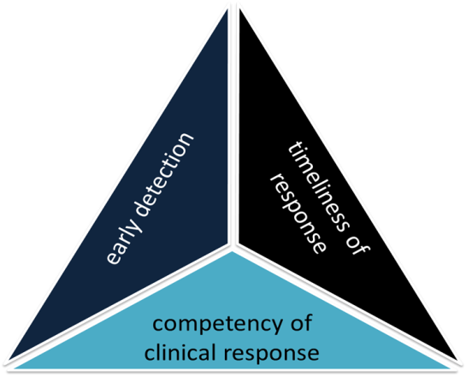
RESTORE2 the whole package
Recognise Soft Signs
Take observations
Calculate NEWS
Escalate using Escalation Tool
Communicate using SBARD
RESTORE2 combines soft signs with NEWS2, a clear escalation pathway designed around care homes and an SBARD communication tool and Action Tracker
RESTORE2Mini combines soft signs and SBARD
Recognise Soft Signs
Get your message across
Take Observations
Get the right help early
Calculate NEWS2
Notes:
Mention that carers are usually the first to recognise soft signs but found it difficult to communicate this concern. NEWS2 allows the carer to escalate their concern to a GP or another professional.

Slide 6
Soft Signs
What are Soft Signs?
Soft Signs are the early indicators that someone might be becoming unwell. You do not have to be a health professional to recognise these signs and as a carer you are ideally placed to recognise small changes in your resident. Often family and friends will pick up on the subtle changes in a person’s behaviour, manner or appearance.

Slide 7
SOFT SIGNS - changes to Mental, Physical, Behaviour
How many times do you receive calls saying:
Mr A is unwell and needs to see a doctor
Mrs B is poorly….not herself
SOFT SIGNS may be communicated by saying:
Mr A has new confusion, a temperature and is breathless
Mrs B is not able to mobilise independently today, shows poor appetite and, where normally very active, has stayed in bed.

Slide 8
Physical Observations
Validated tool widely used in acute care comprising six biological measurements:
Respiration Rate
Oxygen Saturations
Temperature
Systolic Blood Pressure
Heart Rate
Level of Consciousness (defined by ACVPU)
The ACVPU Scale
Level of alertness is measured using ACVPU: Alert,
Newly Confused
responsive only to Voice
responsive only to Pain
Unresponsive

Slide 9
NEWS2
In NEWS2, each vital sign is given a score based on the measurement. The score ranges between zero and increases based on the observations. If someone is on oxygen therapy they score 2, so this would be their baseline. A score of ≥3 needs review

Slide 10
NEWS2 SCORE 0 – 20
The higher the score, the more unwell someone is
BASELINE NEWS SCORE
Calculating a NEWS2 Score when a resident is first admitted provides a baseline of what is normal for the resident. Carers may provide baseline and current NEWS2 score to show deterioration

Slide 11
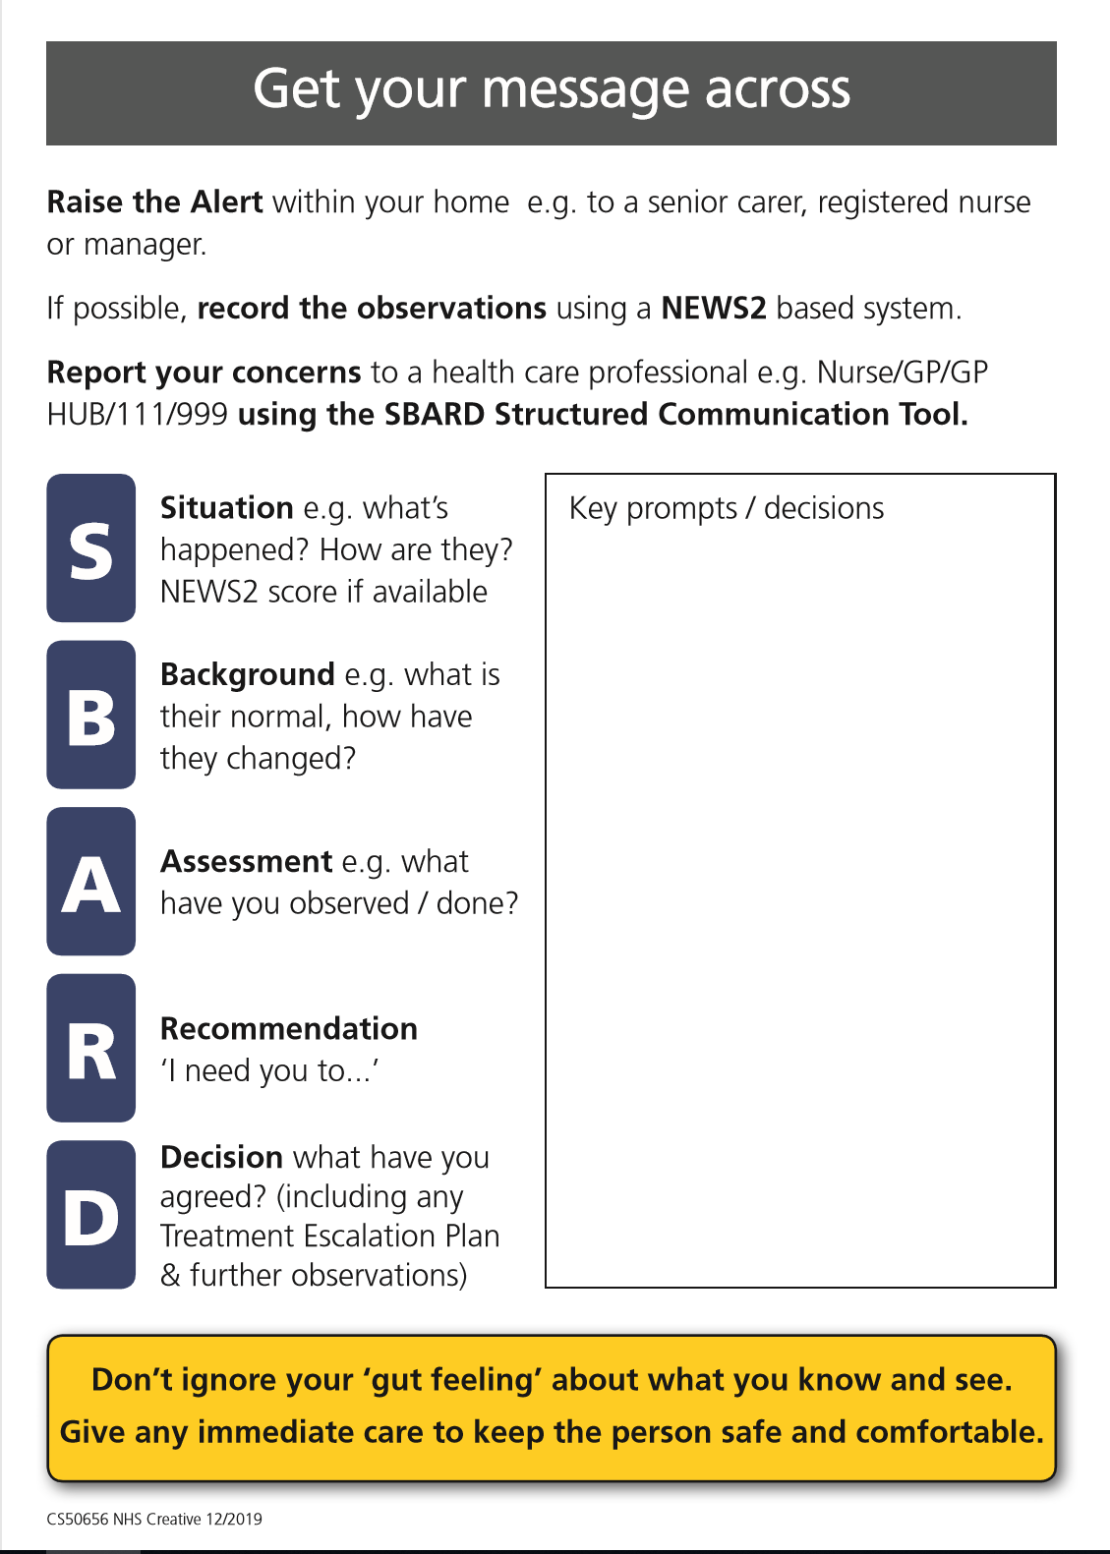
SBARD Communication Tool
Carers are being trained to use the SBARD escalation tool and action tracker to help with communication. Evidence shows that use of the SBARD tool helps with communication, confidence and patient safety.
Once carers have attended the RESTORE2 to training please expect them to discuss their concerns with you in the following format:
Situation
Background
Assessment
Recommendation
Carers will then document
Decision that has been agreed

Slide 12
General Practice protocol
Your practice can or may have developed a protocol for you to use in order to help you react appropriately to messages coming in using the RESTORE2 escalation tool
It is important to remember that this tool is to help clinical staff decide how to respond to deteriorating patients including doing remote consultations, home visits or even admission of the patient to hospital if appropriate
Therefore if you receive a SBARD message about RESTORE 2 from a carer you will need to take some action promptly.
Note: 2 Covid 19 symptoms: temperature and respiratory rate may not trigger a NEWS2 Score – however silent hypoxia has been seen in patients, so many homes are now measuring Oxygen Saturation. It is important to note that an unwell resident may have a normal NEWS score.

Slide 13
SELF-CHECK QUIZ
What does RESTORE2 stand for?
What is RESTORE2 ? (in one sentence)
Why is early detection of deterioration important?
Name 2 benefits of RESTORE2
What does NEWS2 stand for?
What observations have different escalation trigger points during this Covid 19 pandemic?
Please attempt these questions – before moving onto the next slide.

Slide 14
SELF-CHECK QUIZ ANSWERS
What does RESTORE2 stand for? See above.
What is RESTORE2 ? RESTORE2TM is a physical deterioration and escalation package designed specifically for residential and nursing homes. It can also be used in the domiciliary care sector.
3. Why is early detection of deterioration important? Gets the Right Help at the Right Time.
Name 2 benefits of RESTORE2 Keeps Residents SAFE, Avoids 999 Calls, Reduced Admissions
What does NEWS2 stand for? National Early Warning Score
6. What observations have different escalation trigger points during this Covid 19 pandemic?
Temperature, Respiratory Rate. Silent Hypoxia (Low Oxygen Saturations) noted with Covid 19

Slide 15
Concluding Notes
We hope this training has enabled you to learn a little more about what RESTORE2 and RESTORE2 mini are
With training taking place in Somerset Residential and Nursing homes please expect to notice some changes to the information you receive from carers
Primary Care staff can complete online NEWS2 training https://news.ocbmedia.com/ (free to NHS emails)
Please support your local care staff with this change
If you have any questions please contact patricia.hymas@nhs.net

Slide 16
REVIEW of CORE LEARNING OUTCOMES
to know about Restore2 training in homes and the benefits to Primary Care
to know about RESTORE2 and why it is, important
to understand what soft signs are and why they matter.
To understand NEWS2* scores
*Used by Homes that can undertake a full set of physical observations
to expect Carers to use a SBARD format when calling

Slide 17
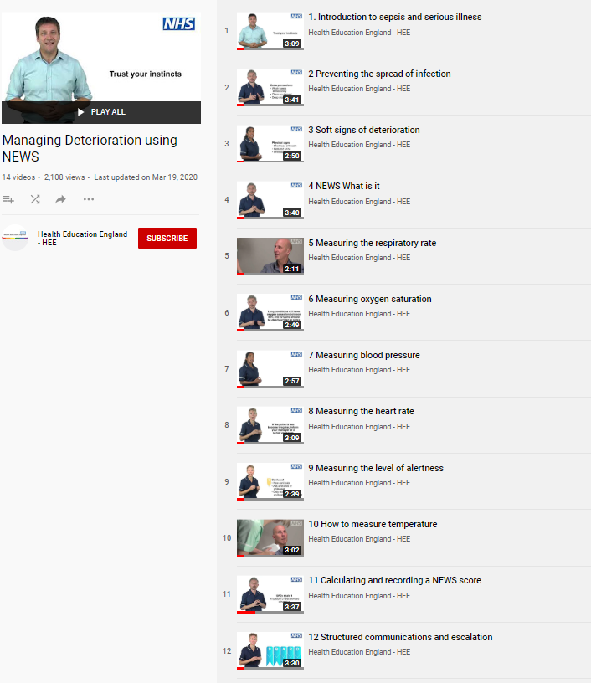
REFERENCES AND RESOURCES
Wessex AHSN and West of England AHSN have collaborated with West Hampshire CCG (RESTORE2) and Health Education England to produce a series of free videos and e-learning materials to support staff working in care homes to care for residents who are at risk of deterioration.
The full set of 14 Managing Deterioration Videos can be accessed via: https://wessexahsn.org.uk/projects/358/care-home-training-resources and individual videos applicable to the use of RESTORE2mini are flagged below with a green tick ( ) and indicated on the relevant slides.
✓
Linking the Managing Deterioration Videos and RESTORE2
Spotting serious illness and sepsis
Some people are more at risk than others of becoming unwell very quickly and developing a serious illness such as sepsis. This is known as ‘deterioration’ and it is important that anyone who cares for individuals who are at risk of deterioration knows how to spot the signs, especially during the current COVID-19 outbreak.
Watch this film
Introduction to sepsis and serious illness
Soft Signs and What’s Normal
What to look out for when it is not appropriate to take measurements of a person’s vital signs.
The RESTORE2 mini tool is helpful in these situations.
A white paper from Geoff Cooper at Wessex AHSN looks at using soft signs to identify deterioration.
Watch these films
Preventing the spread of infection
Soft signs of deterioration
Recognising deterioration with a learning disability
Take Observations
The National Early Warning Score is used by GPs, ambulance services and acute hospital trusts.
RESTORE2 makes NEWS2 more accessible to care and nursing homes.
Watch these films
NEWS: What is it?
Measuring the respiratory rate
Measuring oxygen saturation
Measuring blood pressure
Measuring the heart rate
Measuring level of alertness
How to measure temperature
Calculating and recording a NEWS score
Escalate and Communicate
Effective communication is vital for safety critical messages between different healthcare staff
Watch these Films
Structured communication and escalation
Treatment escalation plans and resuscitation
✓
✓
✓
✓

